Slide 1


01
WELCOME
RESPONSIVE BOOTSTRAP 5 LANDING PAGE COURSE
This Course Sponsered by: darunitbd.com

Slide 2
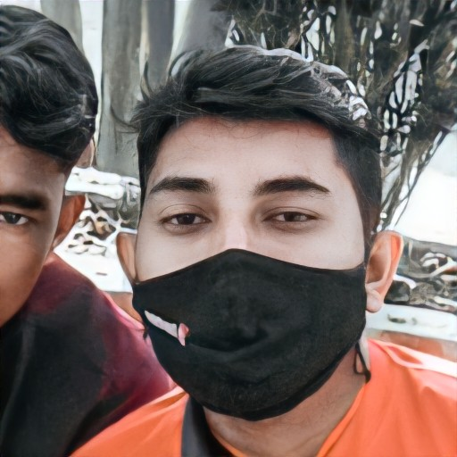
02
“
NAME: MEHEDI HASSAN (JIBON)
STUDY: DIPLOMA IN ENGINEERING
TECHNOLOGY: COMPUTER IN SCIENCE
EXPERIENCE:-
WEB DESIGNER
WEB DEVELOPER
INSTRUCTOR OF THIS COURSE
GRAPHICS DESIGNER
UI/UX DESIGNER
This Course Sponsered by: darunitbd.com

Slide 3
03
“
Pre Requirement for This Course:-
HTML 5 (BASIC)
CSS 3 (BASIC AND ADVANCE)
BOOTSTRAP 5 (BASIC AND ADVANCE)
JQUERRY (Event and Plugin)
This is our Final Project Demo:
..\simple newspaer template\index.html
This Course Sponsered by: darunitbd.com

Slide 4
04
“
DEPLOY WEBSITE IN:
GITHUB (FREE)
NETLIFY (FREE)
This Course Sponsered by: darunitbd.com

